Slide 1

Guessing game
6b86b273ff34fce19d6b804eff5a3f5747ada4eaa22f1d49c01e52ddb7875b4b
D4735e3a265e16eee03f59718b9b5d03019c07d8b6c51f90da3a666eec13ab35
4e07408562bedb8b60ce05c1decfe3ad16b72230967de01f640b7e4729b49fce
4b227777d4dd1fc61c6f884f48641d02b4d121d3fd328cb08b5531fcacdabf8a
random
matching
380,529,357,561,130,800,000
Guesses per second
(CoinWarz, 2023)

Slide 2

How to address the energy consumption in cryptocurrency mining
Changyu Li 20513997

Slide 3

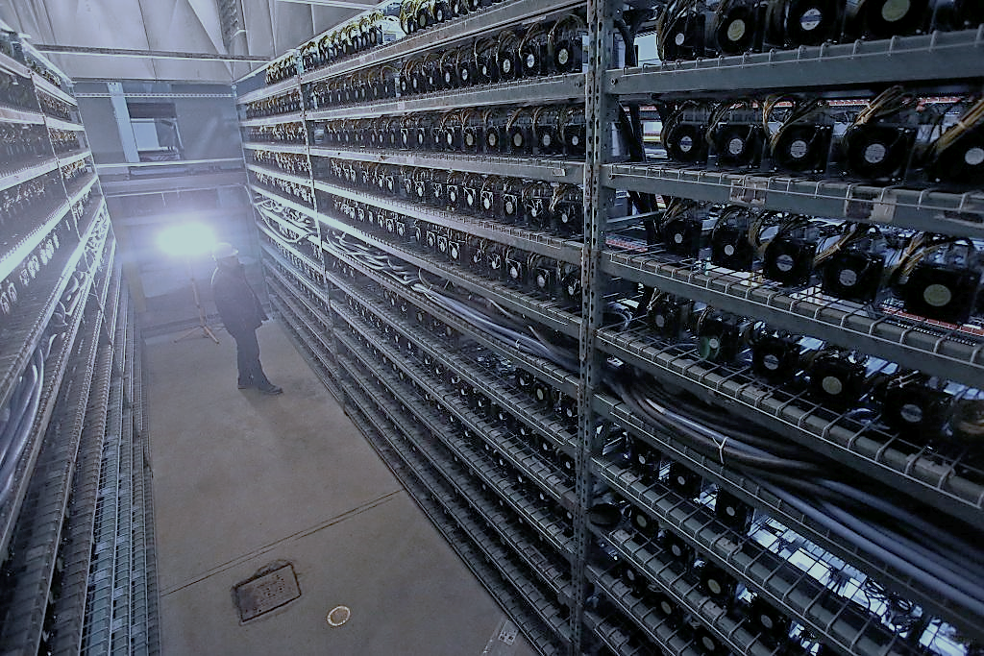
Outline
Problem: The energy consumption in cryptocurrency mining
Explanation
Causes
Impact
Solutions
Mining ban
Proof-of-stake (PoS)

Slide 4
Explanation
What is cryptocurrency?
Digital currency secured by cryptography
What is mining?
Use advanced computer to calculate math puzzles and cost energy
Used to verify transactions and avoid hacking
(Judmayer, 2022)

Slide 5
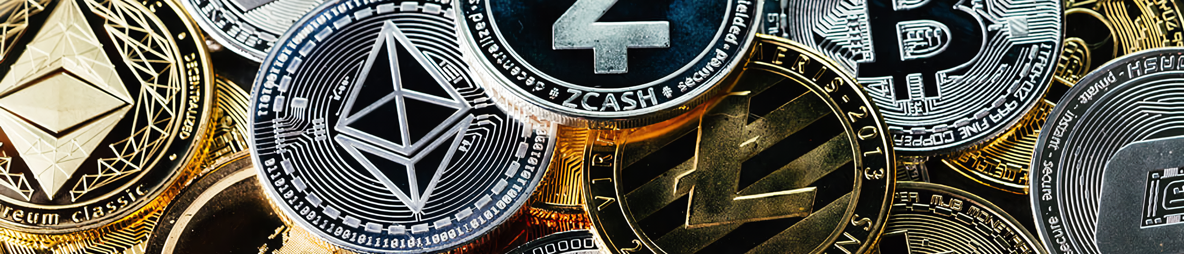
Problem: Causes
Rapid price increases in cryptocurrency from 2019 caused mining fever
Energy consumption increased
Caused more climate damages
(CoinWarz, 2023)

Slide 6
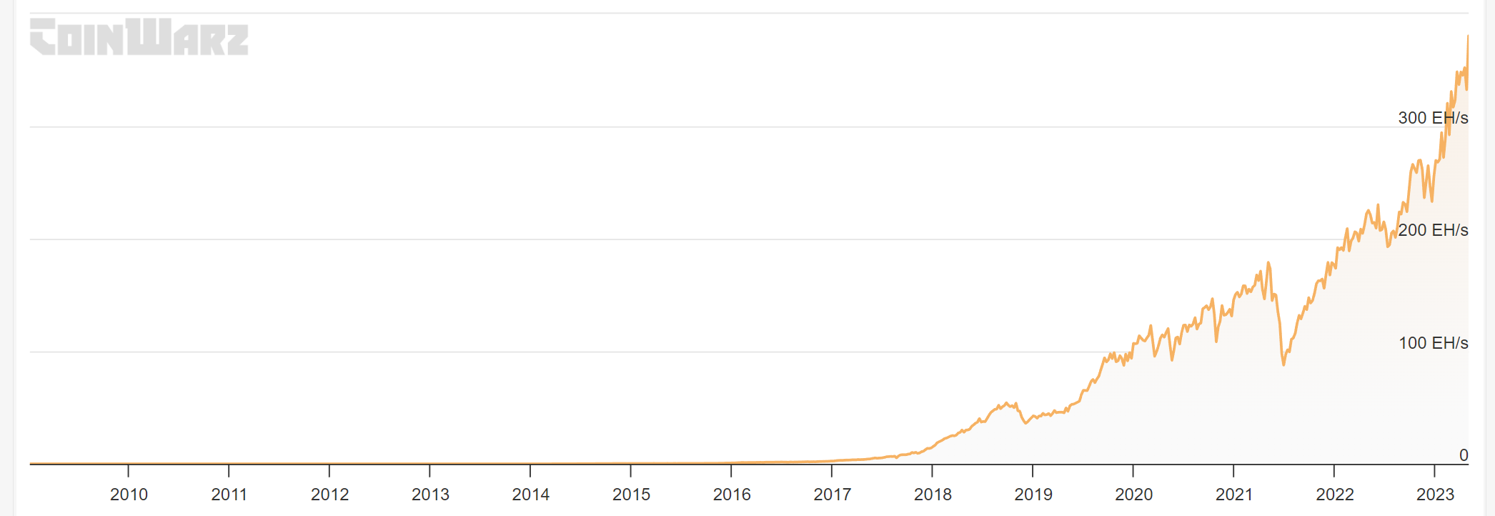
Problem: Causes
Global Bitcoin hashrate (mining power)
(CoinWarz, 2023)

Slide 7
Problem: Impact
Consumes 120 - 240 billion kWh per year
Emitted about 140 million tons of CO₂ per year
(WH, 2022)
Each Bitcoin exhausts about 113 tons of CO₂.
(Jones,2022)

Slide 8
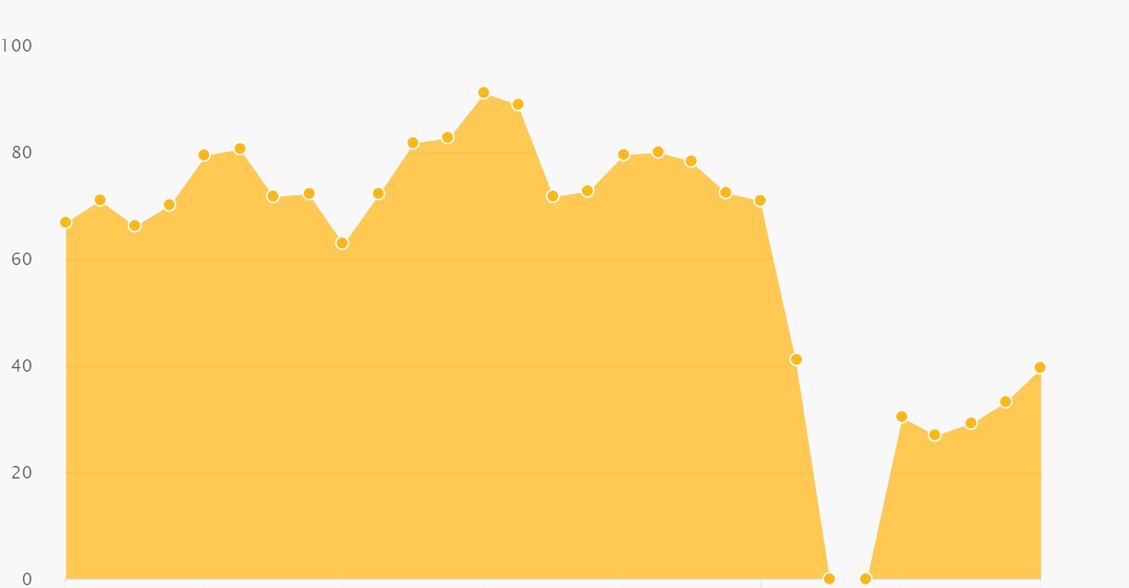
Solution1: Mining ban
Restrict device functionality or use laws to ban mining
Evaluation:
+ Immediate impact
E.g. Nvidia limits mining
China bans mining
Can easily be circumvented
9/2019 5/2021
1/2022
Network hashrate (mining power) in China
(CCAF, 2022)

Slide 9
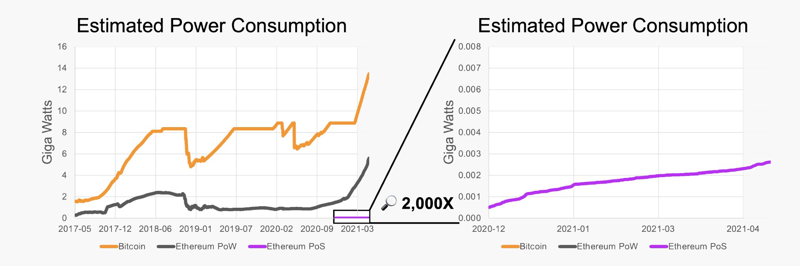
Solution2: Proof-of-stake (PoS)
Another method to verify transactions and earn currency
Replace mining
Evaluation:
+ Save energy
99.95% less energy than Proof-of-Work (mining).
+ Successful transition of Ethereum
Favouring those with more currency
More currencies for richer people
(FTSE Russel, 2022)

Slide 10
Conclusion
Problem: How to address the energy consumption in cryptocurrency mining
Solution:
Mining ban
Proof-of-stake (PoS) method

Slide 11
References
CCAF (2022) Cambridge Bitcoin Electricity Consumption Index [online]. Available at: https://ccaf.io/cbeci/index [Accessed 1 April 2023]
CoinWarz (2023) Bitcoin Hashrate Chart [online]. Available at: https://www.coinwarz.com/mining/Bitcoin/hashrate-chart [Accessed 30 April 2023]
FTSE Russel (2022) Proof-of-Stake: A crypto path to lower energy consumption and yield. London: FTSE Russell. Available at: https://content.ftserussell.com/sites/default/files/education_proof_of_stake_paper_v6_0.pdf [Accessed 1 April 2023]
Jones, B.A., Goodkind, A.L. and Berrens, R.P., (2022). Economic estimation of Bitcoin mining’s climate damages demonstrates closer resemblance to digital crude than digital gold. Scientific Reports 12(1), pp.1-10.
Judmayer et al. (2022). Blocks and Chains: Introduction to Bitcoin, Cryptocurrencies, and Their Consensus Mechanisms. Springer Nature
The White House [WH] (2022) FACT SHEET: Climate and Energy Implications of Crypto-Assets in the United States, Washington, DC: The White House

